Slide 1


Naloxone training
(brand name Narcan)
Please complete the Pre-training
registration and survey

Slide 2
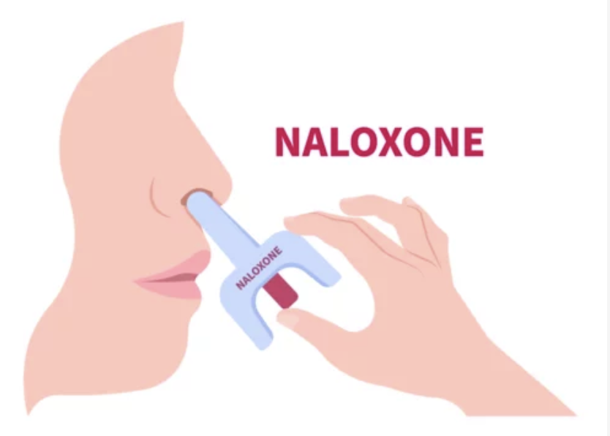
By the end of this workshop, you will be able to:
Discuss the harm of Fentanyl/opioids when misused
Recognize the signs of an opioid overdose.
Respond to an opioid overdose by using nasal Naloxone/Narcan (Two Pack).
Safeguard the community you serve from accidental exposure and overdose death.

Slide 3

Notes:
https://youtu.be/chTuAMh26mg?si=is3FznlDxmo45eKW

Slide 4
What is naloxone
(Narcan)?
Naloxone is a medicine that rapidly reverses an opioid overdose
It blocks opioid receptors and reverses and blocks the effects of opioids.
Naloxone can quickly restore normal breathing to a person if their breathing has slowed or stopped due to opioid overdose.
Naloxone does not affect someone who does not have opioids in their system.
Notes:
Centers for Disease Control and Prevention. (2022, February 8). Naloxone. Centers for Disease Control and Prevention. https://www.cdc.gov/opioids/naloxone/index.html
CDC https://www.cdc.gov/opioids/overdoseprevention/reverse-od.html

Slide 5
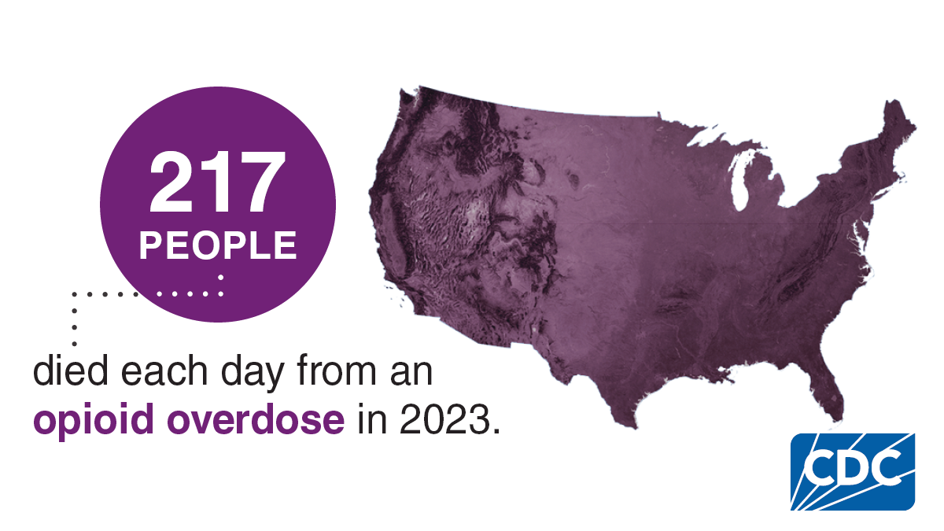
Why is this Opioid epidemic Occurring?
Increased opioid prescriptions.
Polydrug use especially for pain.
Sold through illegal drug markets.
Opioid medications are highly addictive.
Examples of opioids include heroin, fentanyl, oxycodone (OxyContin®), hydrocodone (Vicodin®), codeine, & morphine.
Notes:
In 2023 approximately 105,000 people died from a drug overdose. 76% of these deaths involved opioids. From 2022 to 2023 the opioid overdose death rate declined by 4%. Deaths from synthetic opioids excluding methadone decreased by 2%. The rate of overdose deaths linked to heroin decreased by 33%, and the rate of overdose deaths linked to prescription opioids decreased by 12%. Yet, the number of overdose deaths remain nearly 10 times higher than in in 1999.
Centers for Disease Control and Prevention. (2025, July 12). Understanding the Opioid Overdose Epidemic. Overdose Prevention. https://www.cdc.gov/overdose-prevention/about/understanding-the-opioid-overdose-epidemic.html

Slide 6
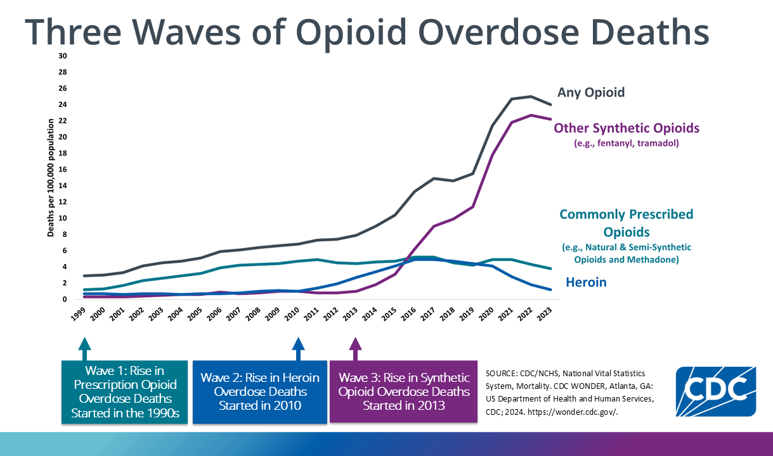

Notes:
CDC graph at https://www.cdc.gov/opioids/basics/epidemic.html
This rise in opioid overdose deaths can be outlined in three distinct waves.
1. The first wave began with increased prescribing of opioids in the 1990s, with overdose deaths involving prescription opioids (natural and semi-synthetic opioids and methadone) increasing since at least 1999.
2. The second wave began in 2010, with rapid increases in overdose deaths involving heroin. Increases in Mexican production ensured a reliable supply of low-cost heroin. As prices declined and availability increased, heroin-related overdose deaths began to rise. From 2010 to 2016, the rate of heroin-involved deaths increased from 1 to 4.9 per 100,000
3. The third wave began in 2013, with significant increases in overdose deaths involving synthetic opioids, particularly those involving illicitly manufactured fentanyl. The market for illicitly manufactured fentanyl continues to change, and it can be found in combination with heroin, counterfeit pills, and cocaine.
4. N-desethyl isotonitazene (NDI) is an active opioid agonist and is approximately 20x more potent than fentanyl.
Centers for Disease Control and Prevention. (2025, July 12). Understanding the Opioid Overdose Epidemic. Overdose Prevention. https://www.cdc.gov/overdose-prevention/about/understanding-the-opioid-overdose-epidemic.html
Duff, J., Lampe, J., Rosen, L., & Shen, W. (2025). The Opioid Crisis in the United States: A Brief History. Congress.gov. https://www.congress.gov/crs-product/IF12260

Slide 7
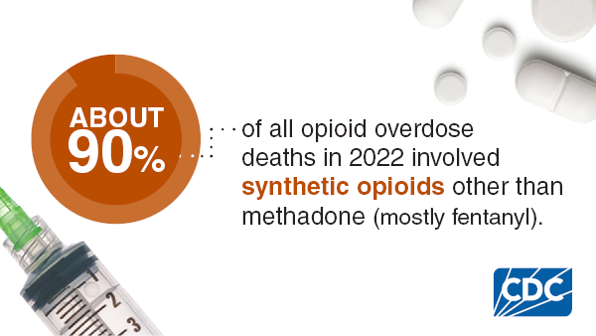
Statistics
Overdose deaths remain a leading cause of injury-related death in the United States.
In a 2016 SAMHSA report, more than 11.5 million Americans reported misusing prescription opioids in the past year.
Synthetic opioid-involved death rates decreased by 2% from 2022 to 2023 and accounted for 92% of all opioid-involved deaths in 2023.
Notes:
Centers for Disease Control and Prevention. (2022, May 23). Opioid basics. Centers for Disease Control and Prevention. https://www.cdc.gov/opioids/basics/index.html
Substance Abuse and Mental Health Services Administration. (2017). Key substance use and mental health indicators in the United States: Results from the 2016 National Survey on Drug Use and Health (HHS Publication No. SMA-17-5044, NSDUH Series H-52). U.S. Department of Health and Human Services. https://www.samhsa.gov/data/sites/default/files/NSDUH-FFR1-2016/NSDUH-FFR1-2016.pdf
Centers for Disease Control and Prevention. (2024, November 7). Overdose Graphics. Overdose Prevention. https://www.cdc.gov/overdose-prevention/communication-resources/overdose-graphics.html
Centers for Disease Control and Prevention. (2025, September 18). About Overdose Prevention. Overdose Prevention. https://www.cdc.gov/overdose-prevention/about/index.html

Slide 8
Opioid Use and Mental Health
1 in 4 adults living with a serious mental health condition also have a substance use disorder
In 2023, 20.4 million adults had a substance use disorder and any mental illness
In 2022 of individuals with opioid use disorder: 36.1% had depression, 29.1% had anxiety, 20.9% had ADHD, 18.1% had PTSD, and 8.7% had bipolar disorder
Notes:
Mental health problems and substance use disorder can occur together because some substances cause people to experience symptoms of a mental health problem or substances may be misused as a form of self-medication. 1 in 4 individuals living with a mental health condition also have a substance use disorder. In 2023, 20.4 million adults in the US had a substance use disorder and any mental illness. Data from 2020 reveals that among individuals with an opioid use disorder ~36% experienced depression, ~30% experienced anxiety, ~21% had ADHD, ~18% had PTSD, and ~9% had bipolar disorder.
SAMHSA. (2023, February 7). What are Co-Occurring Disorders? https://www.samhsa.gov/mental-health/what-is-mental-health/conditions/co-occurring-disorders
National Health Institute. (2025, February 21). Optimizing Collaborative Care for People with Opioid Use Disorder and Mental Health Conditions | NIH HEAL Initiative. https://heal.nih.gov/research/new-strategies/optimizing-care

Slide 9
Opioid use and Maternal Health
In a 2019 survey, 7% of women reported using prescription opioids during pregnancy, and 1 in 5 of these women reported misusing a prescription opioid.
Opioid related diagnoses at delivery increased by 131% between 2010 and 2017.
Overprescribing and leftover medications after delivery results in approximately 20 million opioid tablets available for misuse.
In 2019, 25.6% of PRAMs respondents reported postpartum substance use, 5.9% reported polysubstance use.
Higher substance use prevalence was associated with depression, anxiety, ACEs, and stressful life events.
Notes:
Centers for Disease Control and Prevention. (2025, May 7). About Opioid Use During Pregnancy. Centers for Disease Control and Prevention. https://www.cdc.gov/opioid-use-during-pregnancy/about/index.html
Miller, A. N., Daniels, D. E. N., & Heavey, S. C. (2025). Postpartum Opioid Use in the United States and the Implications to Maternal and Public Health: A Scoping Review. Maternal and Child Health Journal, 29(11), 1541–1555. https://doi.org/10.1007/s10995-025-04163-x
Stewart, A., Ko, J., Salvesen von Essen, B., Levecke, M., D’Angelo, D. V., Romero, L., Cox, S., Warner, L., & Barfield, W. (2023). Association of Mental Health Conditions, Recent Stressful Life Events, and Adverse Childhood Experiences with Postpartum Substance Use ― Seven States, 2019–2020. Morbidity and Mortality Weekly Report, 72(16), 416–420. https://doi.org/10.15585/mmwr.mm7216a1

Slide 10
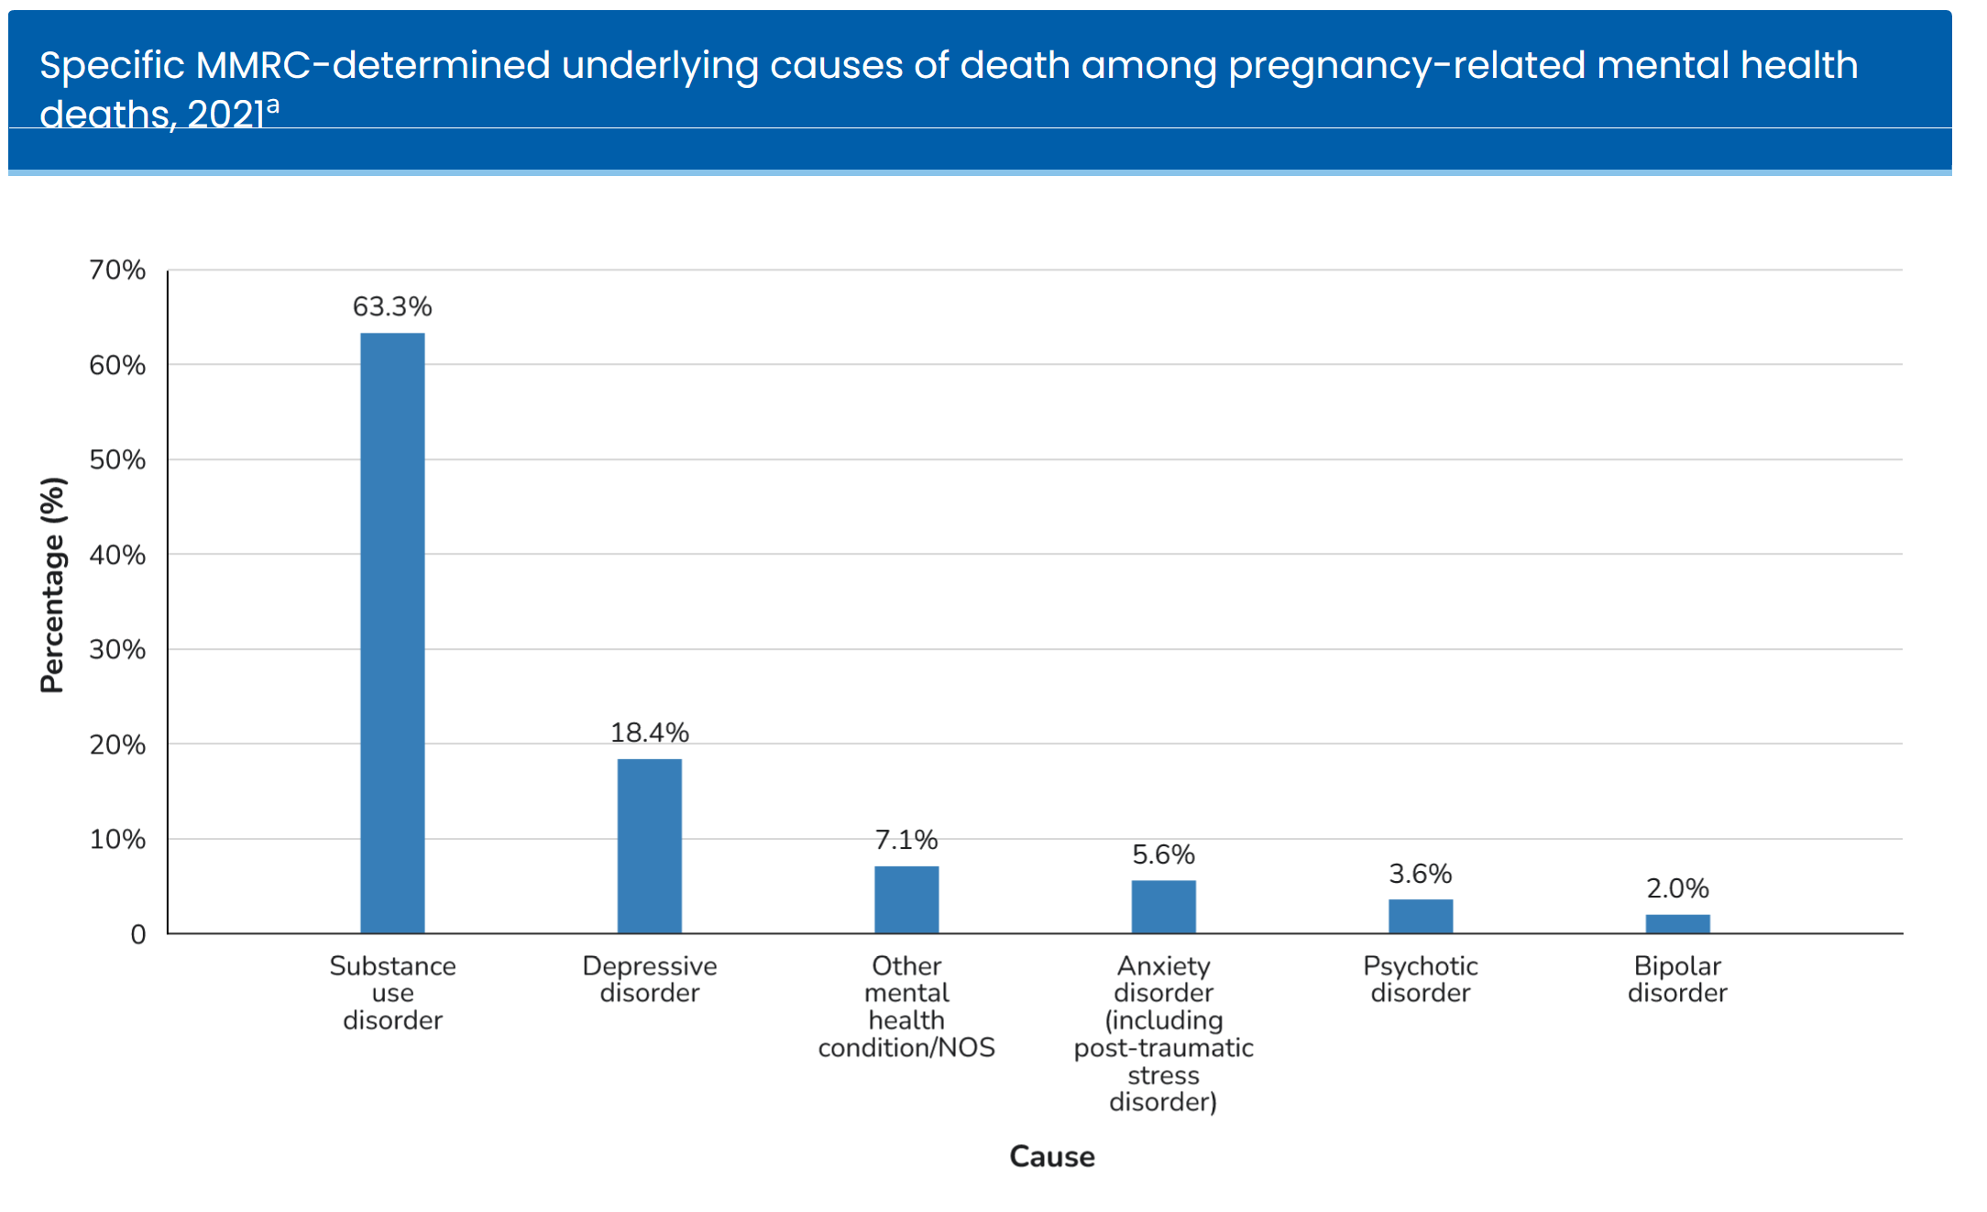
Opioid Overdose and Maternal Health
According to the CDC, substance use disorders contributed to 23.6% of maternal deaths, and mental heath conditions contributed to 22.5% of maternal deaths.
64% of pregnancy related deaths associated with mental health are due to poisoning/overdose.
Notes:
The co occurrence of mental health conditions and opioid use is particularly important for pregnant and post partum women. According to the CDC, substance use and mental health conditions account for 1 in 4 maternal deaths. According to the CDCs report on findings from Maternal Mortality and Morbidity Review Committees, substance use disorders contributed to 23.6% of maternal deaths. Mental health conditions also contributed to 22.5% of maternal deaths. In 2021, of pregnancy related deaths with mental health conditions as the underlying cause 64.7 % were determined to be unintentional or unknown intent poisoning/overdose.
Centers for Disease Control and Prevention. (2025, August 28). Pregnancy-Related Deaths: Data from Maternal Mortality Review Committees. Maternal Mortality Prevention. https://www.cdc.gov/maternal-mortality/php/data-research/mmrc/index.html

Slide 11
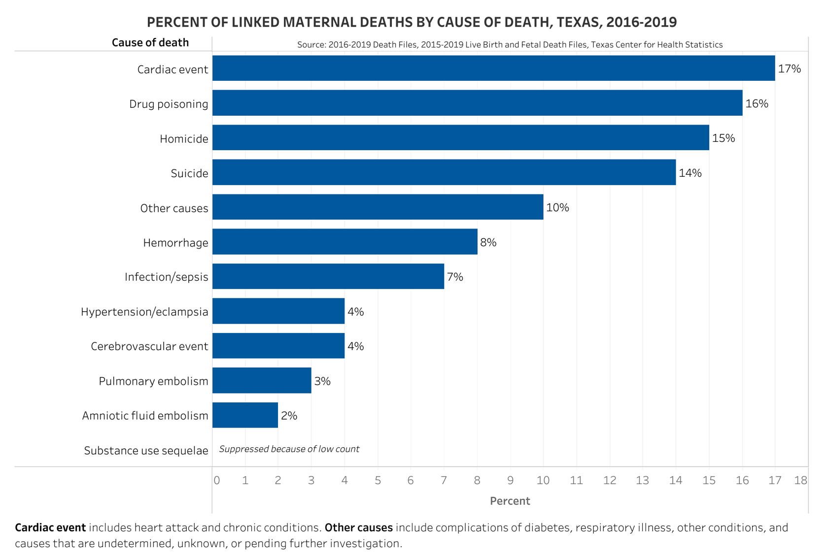
Texas Maternal Deaths 2016-2019
Drug poisoning was the second leading cause of maternal deaths
Suicide was the fourth leading cause of maternal deaths
Notes:
But, what does this mean for Texas Mothers? In Texas drug poisoning or overdose is the second leading cause of maternal deaths. Mental health conditions, specifically suicide, are the fourth leading cause of maternal deaths.
Centers for Disease Control and Prevention. (2025, August 28). Pregnancy-Related Deaths: Data from Maternal Mortality Review Committees. Maternal Mortality Prevention. https://www.cdc.gov/maternal-mortality/php/data-research/mmrc/index.html

Slide 12
What is Fentanyl?
Pharmaceutical Fentanyl is a synthetic opioid, approved for treating severe pain.
It is prescribed in the form of transdermal patches (placed on the skin) or lozenges and can be diverted for misuse and abuse in the United States.
It is 50 to 100 times more potent than morphine.
It can also be used for sale on the streets and disguised using counterfeit or other drugs.
It can additionally be manufactured illegally for sale on the streets.
Notes:
Centers for Disease Control and Prevention. (2022, May 23). Opioid basics. Centers for Disease Control and Prevention. https://www.cdc.gov/opioids/basics/index.html
Centers for Disease Control and Prevention. (2025, June 9). Fentanyl. Overdose Prevention. https://www.cdc.gov/overdose-prevention/about/fentanyl.html

Slide 13

Notes:
Texas Targeted Opioid Response. It’s available at: https://youtu.be/AR7NuBetJJg?si=rwEz_qDfHweZqwA5

Slide 14
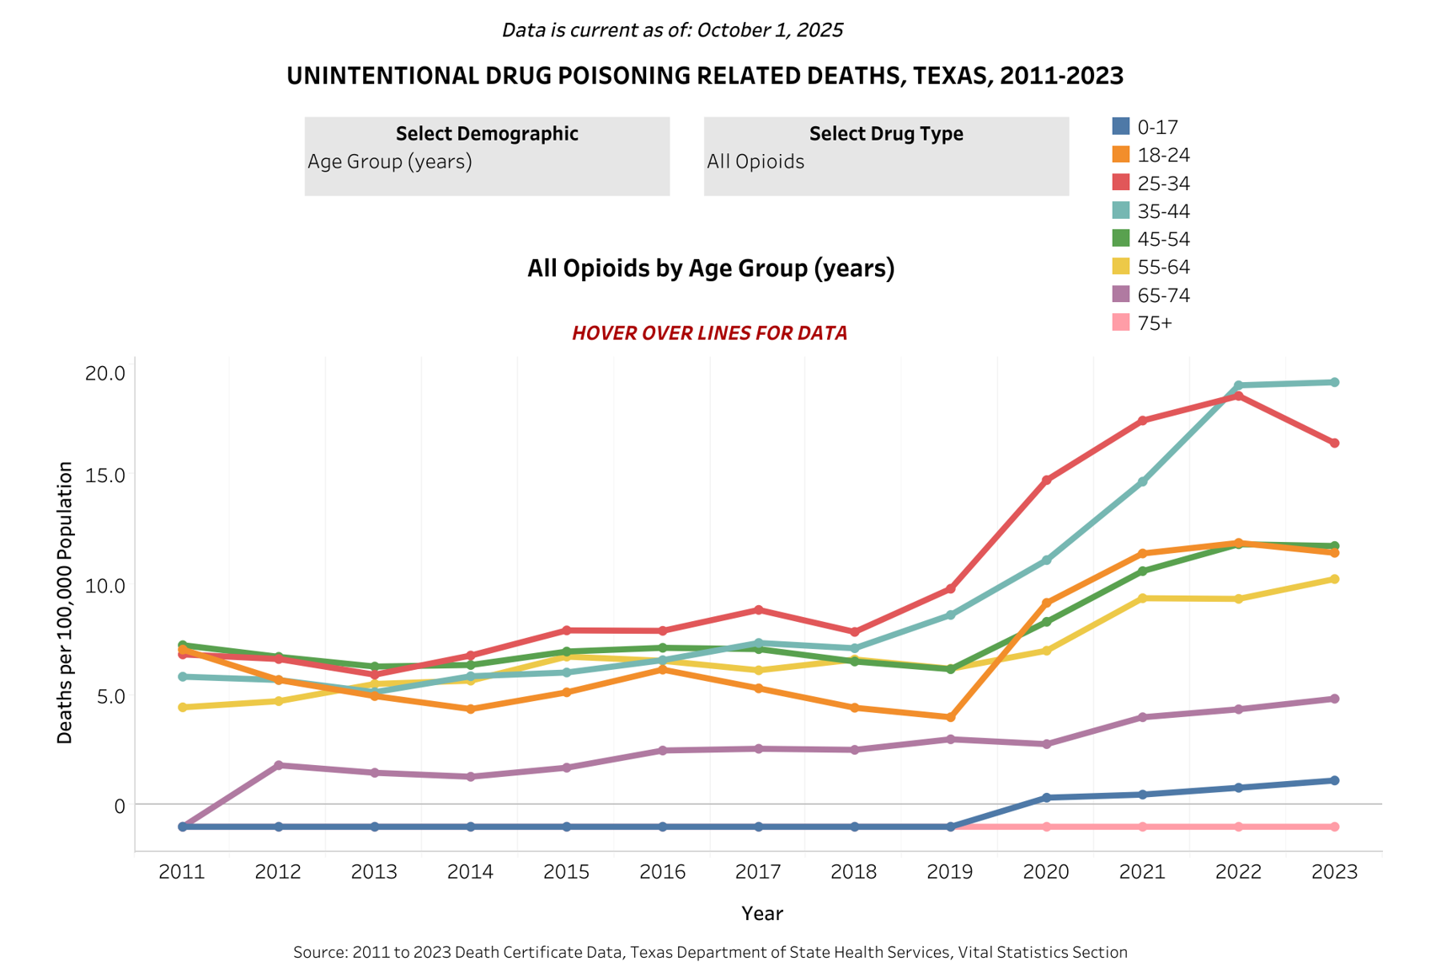
Notes:
Opioid overdose deaths by age. Conveys that the issue impacts people of all age groups. The data is available at https://healthdata.dshs.texas.gov/dashboard/drugs-and-alcohol/all-drugs/drug-related-deaths

Slide 15
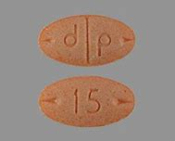
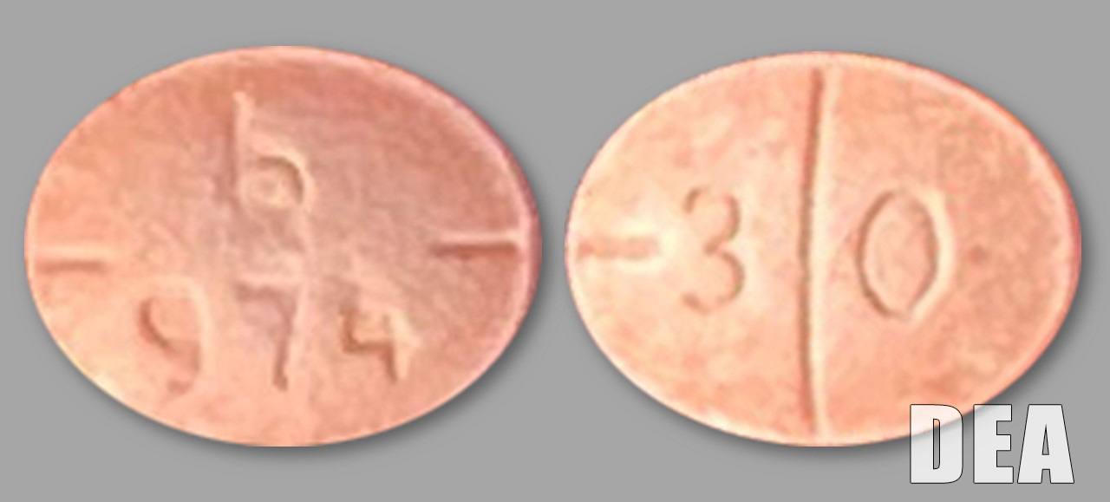
Real Adderall tablets
Fentanyl disguised as medicine
Fake Adderall tablets
Notes:
DEA https://www.dea.gov/onepill

Slide 16
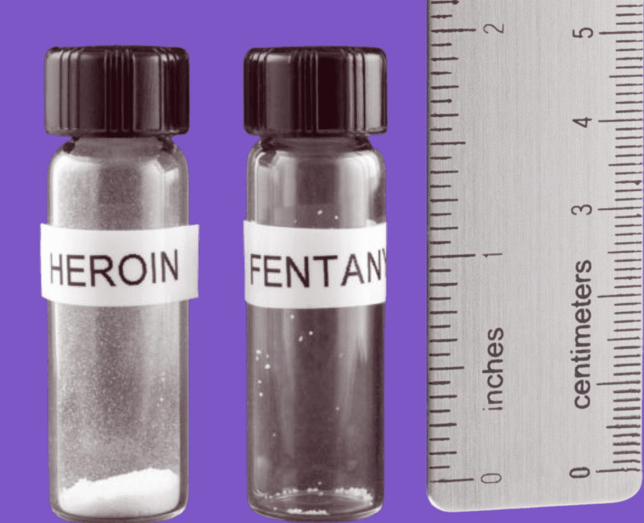
Signs of an opioid overdose:
Small, constricted “pinpoint pupils”
Face is extremely pale and/or feels cold or clammy to the touch
Body goes limp
Fingernails or lips have a purple or blue color
Vomiting or making gurgling noises
Cannot be awakened or unable to speak
Breathing or heartbeat slows or stops
Notes:
CDC https://www.cdc.gov/opioids/overdoseprevention/index.html

Slide 17

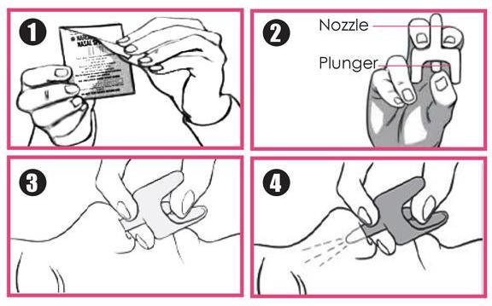
Giving Naloxone
Check for Responsiveness
Call 911
Roll onto back
Open Narcan package
Head tilt – Chin Lift
Insert fully into 1 nostril
Depress plunger
Notes:
Mayo Foundation for Medical Education and Research. (2023, May 1). Naloxone (nasal route) proper use. Mayo Clinic. https://www.mayoclinic.org/drugs-supplements/naloxone-nasal-route/proper-use/drg-20165181

Slide 18
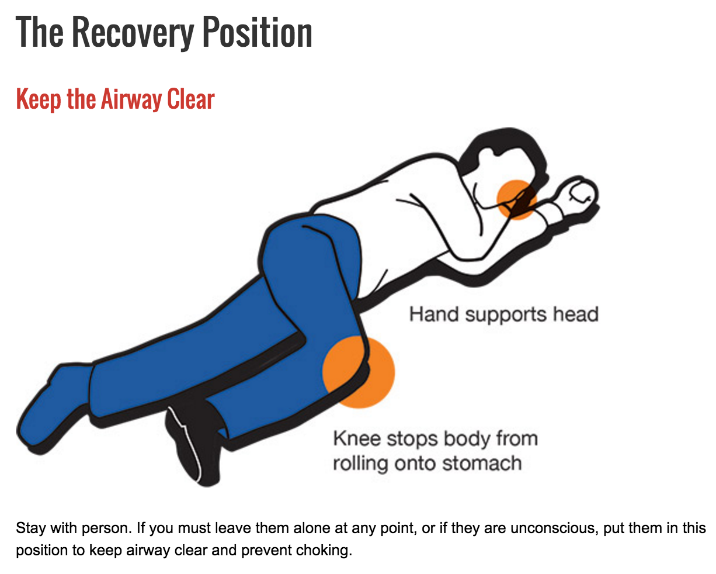
Recovery Position
Move the patient to their left side (recovery position) after giving Narcan.
Watch the patient closely.
Additional doses may need to be given every 2 to 3 minutes until the patient responds or emergency medical assistance arrives.
Narcan can wear off in 15 minutes
If EMS not arrived, and the patient goes back into respiratory distress
Administer second dose
Notes:
Mayo Foundation for Medical Education and Research. (2023, May 1). Naloxone (nasal route) proper use. Mayo Clinic. https://www.mayoclinic.org/drugs-supplements/naloxone-nasal-route/proper-use/drg-20165181

Slide 19
Naloxone reverses the effects of opioid substances.
Naloxone does not reverse the effects of non-opioid substances.
However, because substances are sometimes mixed with opioids, naloxone should still be used.
Giving naloxone will not harm someone if you give it to them and they are not overdosing on an opioid.
Notes:
Centers for Disease Control and Prevention. (2022, February 8). Naloxone. Centers for Disease Control and Prevention. https://www.cdc.gov/opioids/naloxone/index.html

Slide 20

Expired Prescription Disposal
Dispose of Unused or Expired Prescriptions Properly
You can find your nearest drug take-back site:
https://uh.edu/pharmacy/research/centers-and-institutes/the-premier-center/community-outreach/
Naloxone Expiration Info
Expiration between 24-36 months
Call manufacturer or visit website to verify if expiration date has been extended.
Notes:
University of Houston: For awareness, safe disposal materials are available for pick up at community locations throughout Texas. Learn more at https://uh.edu/pharmacy/research/centers-and-institutes/the-premier-center/community-outreach/.

Slide 21

Questions

Slide 22
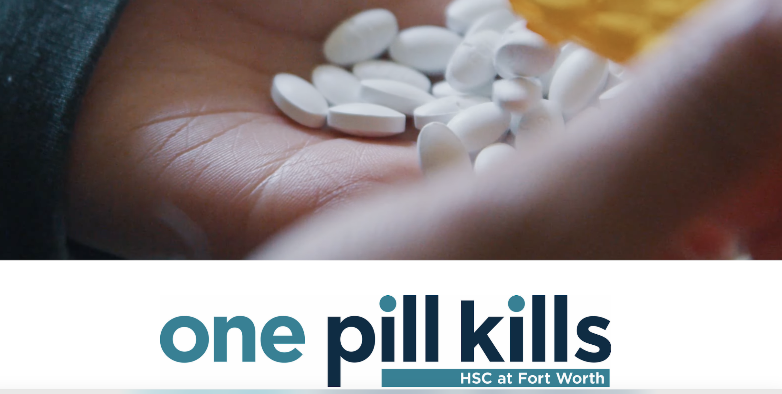
Go to Website
Notes:
https://www.unthsc.edu/one-pill-kills/

Slide 23
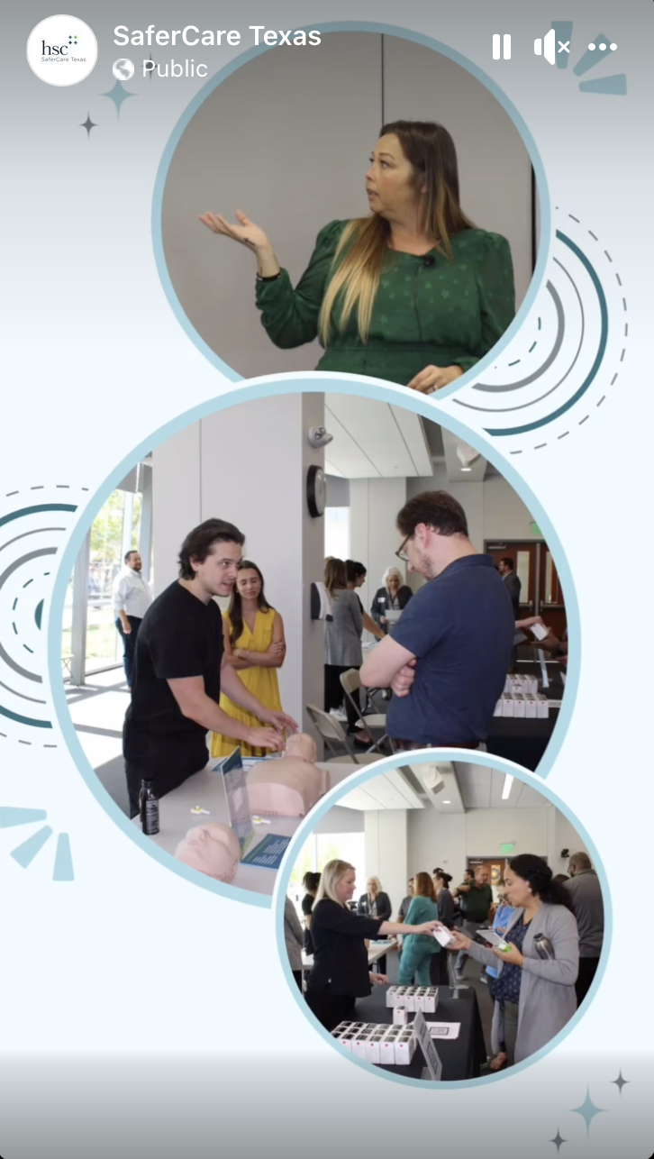

Let’s Practice
Please complete the Post-survey

