Slide 1

Office of Institutional
Integrity and Awareness
Legacy 2030
The Timeless Impact of Integrity
2025-2030 Strategic Plan

Slide 2

OIIA Vision Objectives and Key Results
1 | Enhance Core Services Provide paramount services and ethical leadership with excellence. | Integrity Framework: Everyone is utilizing the integrity framework. Engagement: All customer segments are highly engaged. Risk Management: Compliance risk management processes are protecting all stakeholders. Ethical Leadership: Establish an Institute of Ethical Wellness
2 | Innovative Solutions Deliver new services and expanded leadership for better healthcare. | AI: Utilize AI ethically and effectively throughout HSC. Leadership: Provide global leadership in healthcare education by operating an external leadership platform for the integrity framework. Budget: Secure additional budget annually through diverse funding sources to expand our resources and improve our services.
3 | Remarkable Team Define a transformative team that thrives together and delivers positive impact. | Staff Development: Provide world-class development opportunity for the OIIA team to help individuals and the organization to succeed. Communication: Effective communication is fostering unity, collaboration, and excellence. Team Leadership: Lead healthcare and higher education as a team.
4 | Awareness & Influence World renowned for integrity practices, leadership, and support. | Visibility: Increase global visibility in education and healthcare. Influence: Provide integrity leadership and resources that are influencing HSC and beyond. Expansion: Expand wellness services in more communities.
2025-2030 OIIA Strategic Plan
Our Mission
Create solutions for a healthier community.
Our Vision
Cultivate transformative integrity leaders for dynamic healthcare.
Our Values
Courageous Integrity
Be Curious
We Care
Better Together
Show Your Fire

Slide 3
Foreword
Purpose of the Plan
Writing a strategic plan is crucial because the fields of education and health care are rapidly changing. A strategic plan acts like a roadmap, helping an organization make decisions that aligns to its main goals and values. It helps an organization actively shape its future instead of just reacting to changes. Especially now, with fast tech advances and the need for ethical behavior, a strategic plan is key to keeping an organization relevant, impactful, and to mitigate risk.
Outcomes
The expected outcomes of this strategic plan are to build a strong culture of integrity that influences every part of the organization and to create healthier communities. This work will boost trust and cooperation among all people involved. It will lead to ethical practices in education and health care, inspiring others to follow. By adopting new technologies and best practices, the plan also aims to make operations more efficient and effective, which improves the services provided. Overall, the plan isn’t just about handling today's challenges—It's about ensuring a culture where integrity and excellence are actively embraced in every decision and action.

Slide 4
What We Do & Who We Serve
What We Do
Comprehensive organizational compliance programs are common in many industries and are increasingly important in higher education.
The Office of Institutional Integrity and Awareness (OIIA) creates an integrity-based approach program that emphasizes responsibility for ethical behavior and commitments to our Code of Culture. The Integrity Program integrates and coordinates our values with all significant requirements with which HSC must comply by law, regulation, or other binding rules or agreements.
Who We Serve
The University of North Texas Health Science Center (HSC) is a value-based institution with six colleges located on one campus in the heart of Fort Worth, Texas Cultural District. Our work impacts thousands of students and employees of the institution, and many thousands more in the public domain be it patients, research beneficiaries, or those utilizing its resources and information.

Slide 5
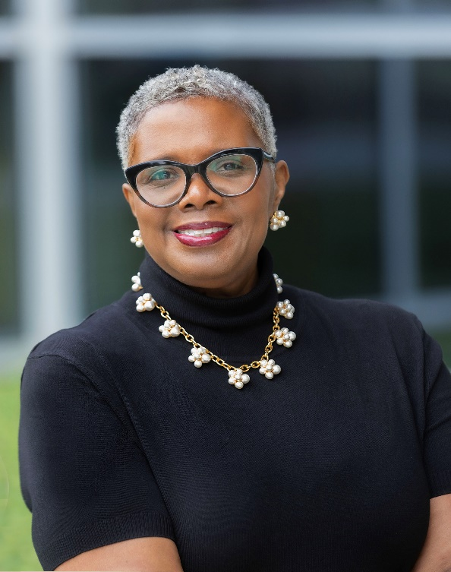
Message from the Chief Integrity Officer
In higher education and health care, maintaining compliance and integrity amidst technological advances, regulatory changes, and increased scrutiny is paramount. The Integrity Framework is crucial for upholding standards, preventing fraud, ensuring fairness, and fostering innovation. Ethical wellness initiatives further enhance organizational culture by promoting individual well-being and embedding ethical principles into daily operations.
Integrating AI and machine learning enhances transparency, facilitates collaborations, and effectively manages compliance and integrity risks across academia, research, and health care. Developing integrity leaders positions institutions as ethical governance pioneers, attracting top talent and benefiting their communities.
Developing integrity leaders positions HSC as a pioneer in ethical governance, attracting top talent and benefiting our community. As expectations for accountability rise, being an integrity leader becomes vital to fostering a dynamic campus environment for the future of health care, where all employees and students embody ethical principles in decision-making and set a standard that influences others.

Slide 6
Who are Integrity Leaders
Integrity is a quality that transcends titles and positions. Being an integrity leader means consistently adhering to principles of honesty, transparency, and ethical behavior. Every individual has the capacity to be an integrity leader. Integrity leaders inspire trust and respect by demonstrating unwavering integrity in their words and actions. They foster a culture that promotes open communication and values different perspectives.
Essentially, everyone can be an integrity leader by making a commitment to uphold ethical standards and lead by example. It's not about the position you hold or the title you carry, but rather the choices you make and the values you uphold that define an integrity leader.

Slide 7
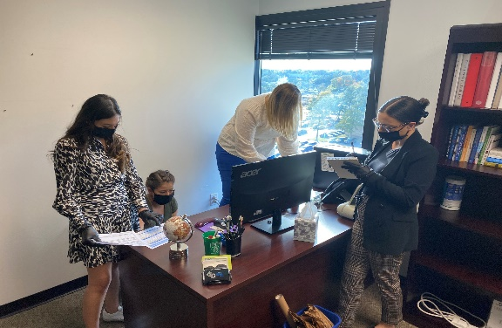
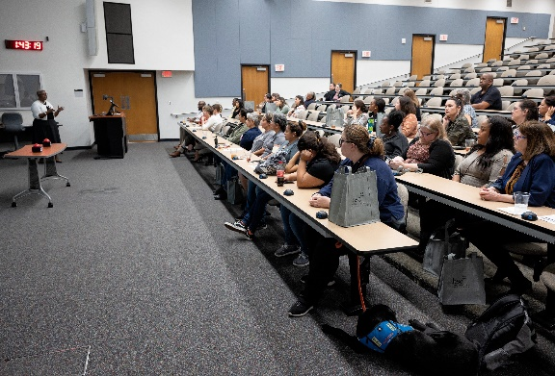
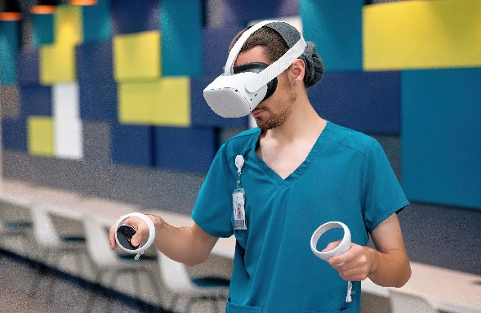
Strategic Challenges
Education and health care will look differently in 2030 and OIIA can transform its services and to innovate programming. Doing so will expand its leadership influence in integrity and risk management, creating solutions for healthier communities.
As rapid industry and culture shifts arise, OIIA must have a framework for prioritizing efforts with strategic goals and organization direction. Opportunities such as expanded leadership, delivering externally-focused resources, increasing budget, and serving new communities will draw attention from core services, requiring careful coordination.
Establishing a remarkable team and integrating advancing technologies such as artificial intelligence are paramount to OIIAs success. It must also scale engagement with core customer segments and communication delivery.

Slide 8
Do Nothing Strategy
Enhancing Core Services:
We will fail to meet increasing demands and decrease stakeholder satisfaction.
Inefficiencies and outdated practices will reduce our effectiveness as integrity leaders.
We will be unable to scale services, hindering organizational growth and customer engagement.
Innovative Solutions:
We will lag behind in AI and tech advancements, losing our competitive edge.
We will miss opportunities to streamline with AI, compromising decision-making.
Lack of innovative approaches will slow our adaptation to market and industry changes.
Remarkable Team:
Lower employee morale and retention will impact our performance.
We will struggle to attract top talent, limiting our ability to drive excellence.
Limited professional development will lead to stagnation of team skills.
Influence and Awareness:
We will have less recognition and respect, reducing our advocacy for integrity.
We will miss engagement opportunities, limiting our community impact.
Weak brand presence will diminish our influence on industry standards.

Slide 9
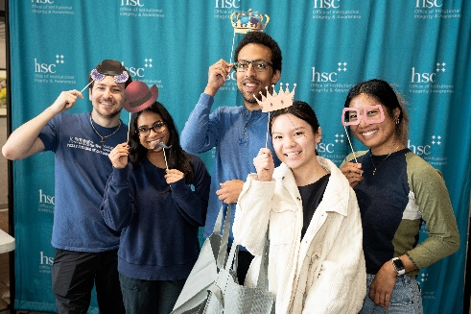


Current State Summary
OIIA faces pivotal strategic questions internally, such as embedding the integrity framework, integrating modern technologies, building a remarkable team, expanding engagement and influence. Externally, OIIA has challenges to increase visibility, establish an influential relationship network, serve new populations, and evolve along with changing regulations and industries.
OIIAs strength lies in its leadership team, expertise, trusted reputation, compliance excellence, forward thinking culture, and history.
Mega trends including regulation shifts, higher education experience changes, strained resources, and workforce dynamics pose challenges, but opportunities abound in integrity framework leadership, servicing additional community groups, and industry influence.

Slide 10
Mega Trends
This PESTLE analysis offers a strategic overview of external factors affecting the organization's integrity program and its wider goals, particularly in terms of enhancing engagement with customer groups and preparing health care leaders for the future.
Political Trends
1. Shifting government regulations impact operational compliance. 2. Higher education and health care are subject to changes in policy and patient care directives, particularly looking towards 2030.
Economic Trends
1. Changing funding models for higher education leading to increased costs and potential accessibility issues. 2. The necessity for health care organizations to adapt to the evolving economic landscape of health care delivery.
P
E
Social Trends
1. The evolving landscape of student engagement with higher education, including the rise of online learning. 2. Sociocultural trends influencing the need for integrity and ethical leadership training.
Technological Trends
1. Utilization of AI and other technologies to enhance departmental processes and compliance. 2. The transformative potential of technology in education and healthcare, with an emphasis on using AI responsibly.
S
T
Legal Trends
1. A focus on compliance monitoring and risk assessment to stay abreast of legal requirements. 2. Incorporating AI into processes must adhere to governance frameworks for ethical use, accountability, and transparency.
Environmental Trends
1. Flexible building infrastructure responsive to the increase in remote work and learning, potentially reducing facility carbon footprints. 2. Considering the broader impact of educational and health care institutions on the community and environment, particularly in Fort Worth and beyond.
L
E

Slide 11
How must OIIA advance to be worldwide integrity leaders for better health care?
Guiding Principles
We will prioritize ethical behavior and decision-making in all actions and policies.
We will maintain open communication and hold ourselves accountable for our commitments and outcomes.
We will foster a culture of ongoing learning and innovation to adapt to changing needs and challenges.
We will encourage collaborative teamwork and inclusive approaches that value a wide-range of perspectives and contributions.
We will actively champion ethical awareness and empathy
We will anticipate challenges and opportunities, leading with foresight and a commitment to positive change.

Slide 12
Integrity First
We will prioritize ethical behavior and decision-making in all actions and policies.
Transparency & Accountability We will maintain open communication and hold ourselves accountable for our commitments and outcomes.
Continuous Improvement
We will foster a culture of ongoing learning and innovation to adapt to changing needs and challenges.
Collaboration
We will encourage teamwork and inclusive practices that value diverse perspectives and contributions.
Proactive Leadership
We will anticipate challenges and opportunities, leading with foresight and a commitment to positive change.
Principles Guiding Our Growth
Rules of the Road

Slide 13
Our Partners
Primary Partners
Employees Faculty / Staff
Students Graduate / Undergraduate
Patients HSC Health / Human Subjects
Secondary Partners
Greater UNT System
Suppliers
Other Higher Education Institutions
Other Healthcare Providers
Government State / Federal / County / City of Fort Worth
General Community Neighbors / Donors / Alumni / Vendors / Business Partners

Slide 14

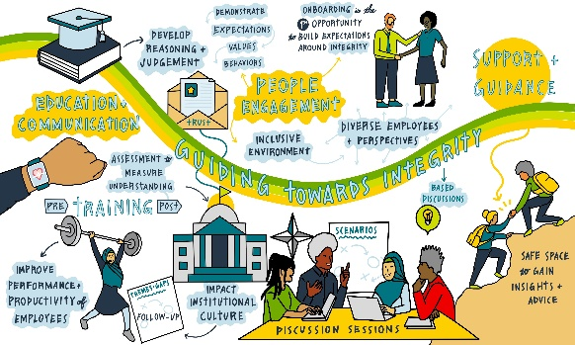
Customer Value and Lasting Impact
The most important value we can provide to our customer is practical integrity framework services because health care and education are rapidly changing.
Our lasting impact to our customer will be a legacy model of integrity that permeates all aspects of the institution.

Slide 15

Our Mission
Create solutions for a healthier community.
Our Values
Courageous Integrity
Model exceptional standards and act in the best interest of our community.
We Care
Complete perspective from Executives, Directors, Managers & Staff. Conduct competitive analysis and customer research.
Show Your Fire
Exhibit passion and pride in the experiences we create.
Be Curious
Cultivate opportunities for learning, creating, discovering, and innovating.
Better Together
Foster an inclusive environment of respect, belonging, and access for all.

Slide 16
Our Vision
What does success look like?
Cultivate transformative integrity leaders for dynamic health care.
LEADERSHIP
Cultivating integrity leaders and influencing the globe.
EMPOWERMENT
Providing the resources and services to navigate the ever-changing industries of education and health care.
INNOVATION
Delivering services, programming, and products that inspire solutions for healthier communities.

Slide 17
Vision Statement: Cultivate transformative integrity leaders for dynamic healthcare.
Our Vision
The Office of Institutional Integrity and Awareness envisions itself as the premier leader in the practical application of the integrity framework. We recognize that prioritizing our values is paramount to upholding integrity. In an era marked by rapid evolution in health care and education, our aim is to empower both our campus and community with the requisite tools and guidance to navigate these changes ethically and effectively. Our enduring legacy lies in cultivating transformative integrity leaders and facilitating enhanced health care outcomes, thereby fostering a culture rooted in trust, accountability, and excellence.
Our Bold
Expanded
Vision

Slide 18
Strategic Goals and Objectives
Strategic Goals
What the key areas of focus to achieve our vision?
If you use this site regularly the great business and would like to the best design professional help keep the site on the Internet.
1
2
Enhance Core Services
Provide paramount services and ethical leadership with excellence. Success looks like…Integrating the integrity framework into all our work to be an effective partner and to ensure stability in the institutional culture and environment.
Innovative Solutions
Deliver new services and expanded leadership for better healthcare. Success looks like…Proactively address emerging trends and risks and ensure compliance utilizing advanced technologies and immersive educational solutions.
3
4
Remarkable Team
Define a transformative team that thrives together and delivers positive impact. Success looks like…Create a team that is proactively developing and working together to drive strategic goals effectively and efficiently.
Awareness & Influence
World renowned for integrity practices, leadership, and support. Success looks like…Distinguished strategic partner in ethical decision-making and increase visibility and importance of integrity programs to the campus, nationally and globally.

Slide 19
1 | Enhance Core Services Provide paramount services and ethical leadership with excellence. Success looks like… Establishing ethical leaders in education and healthcare.
1
2
OIIA Objectives (We will achieve…)
Integrity Framework: Everyone is utilizing the integrity framework.
Engagement: All customer segments are highly engaged.
Risk Management: Compliance risk management processes are protecting all stakeholders.
4. Ethical Leadership: Establish an Institute of Ethical Wellness.
Looking Ahead (We will know we’re there when…)
We have fully integrated the integrity framework into all of our work.
We have provided stability in the institutional culture and environment.
We have de minimis investigations (risk mitigation).
Ethical Wellness as a part of Whole Health.
Strategic Shifts (In the next 3+ years…)
1
Integration of Integrity Framework
Greater investment in the integration of the integrity framework. _
Risk Management
Greater focus on risk management practices. _
Customer Engagement
Greater engagement efforts with primary customer segments. _
More Training
Increased resources and trainings. _
Ethical Leadership
Incorporate workplace wellness to encourage ethical behaviors.
2
3
4
5

Slide 20
2 | Innovative Solutions Deliver new services and expanded leadership for better health care. Success looks like… Proactively addressing emerging trends, risks, and ensuring compliance utilizing advanced technologies and immersive educational solutions.
1
2
OIIA Objectives (We will achieve…)
AI: Utilize AI ethically and effectively throughout HSC.
Global Leadership: Provide global leadership in health care education by operating an external leadership platform for the integrity framework.
Budget: Secure additional budget annually through diverse funding sources to expand our resources and improve our services.
Looking Ahead (We will know we’re there when…)
We have established AI ethical standards, governance, and trainings for HSC.
We are operating an external leadership platform.
We have secured additional revenue streams.
Strategic Shifts (In the next 3+ years…)
1
Readiness
Greater readiness to integrate modern technologies.
Using AI Ethically
Utilization of AI ethically throughout HSC.
Investment
Investment in new deliverables to expand budget.
External Leadership Platform
Operate an external leadership platform.
Partnerships Outside HSC
Explore partnerships and opportunities outside of HSC.
2
3
4
5

Slide 21
3 | Remarkable Team Define a transformative team that thrives together and delivers positive impact. Success looks like… Creating a team that is proactively developing and working together in order to drive strategic goals effectively and efficiently.
1
2
OIIA Objectives (We will achieve…)
Staff Development: Provide world-class development opportunity for the OIIA team to help individuals and the organization to succeed.
Communication: Effective communication to foster unity, collaboration, and excellence.
Team Leadership: A sought-after team leading in healthcare and higher education.
Looking Ahead (We will know we’re there when…)
We have a fully staffed team with the needed abilities.
We have communications and work practices that synergize our work.
We are transforming education and health care through expanded leadership.
Strategic Shifts (In the next 3+ years…)
1
Team Development
Greater investment in developing the OIIA team.
Communication + Relationships
Increased focus on communications and relationships.
Expand Impact
Expand impact beyond core services.
2
3

Slide 22
4 | Influence & Awareness World renowned for integrity practices, leadership, and support. Success looks like… Being sought out for health care solutions.
1
2
OIIA Objectives (We will achieve…)
Visibility: Increase global visibility of integrity leadership in education and health care.
Influence: Provide integrity leadership and resources that are influencing HSC and beyond.
Expansion: Expand ethical wellness as a part of whole health in more communities.
Looking Ahead (We will know we’re there when…)
OIIA has an exceptional reputation and prominence beyond HSC.
We are influencing HSC decision-making, the education and health care industries.
We are bringing solutions to new neighborhoods and people groups.
Strategic Shifts (In the next 3+ years…)
1
Broader Communication
Investment in publicity and broader communication deliveries.
Impact Outside HSC
Greater focus on broadening OIIAs impact outside of HSC.
New Customers
Identify new neighborhoods and people groups to serve.
Unite Health and Education
Create events that bring people together for health and education.
2
3
4

Slide 23
Multiplying Our Mission with AI
By…
Providing usage standards, understanding, tools & training to help predict, design and streamline the current process that we have in place to serve more customers.
Multiplying our mission means we could…
We want to forge external partnerships and relationships to tell the story and to create revenue generation.
Increases the productivity of audits and mitigate the financial liability.
We will have more minors on campus in order to increase our academic footprint in the future.

Slide 24
1 | Ethics First, Technology Second. Ensure that all AI deployments uphold core ethical standards and values, respecting individual rights and societal norms.
2 | Garbage In, Garbage Out. Commit to using high-quality, representative data to train AI systems, ensuring their outputs are reliable and valid.
3 | Open AI, Open Minds. Maintain a transparent approach about how AI technology functions and are employed, allowing for informed consent and understanding.
4 | People Over Pixels. Prioritize privacy, dignity, and the human elements in all AI applications, safeguarding personal information and human well-being.
5 | Accessibility is Non-negotiable. Ensure that AI solutions are accessible to all individuals, including those with disabilities, complying with the ADA to foster inclusivity.
6 | Augment, Not Replace. Use AI to enhance & augment human capabilities and decision-making, not to substitute them, recognizing the unique strengths of human judgment.
Our AI
Guiding Principles

Slide 25
We will fail to provide necessary guidance to align with evolving health care practices and AI integration.
We will be unable to develop innovative AI programs that address future educational needs.
We will miss the chance to educate and guide students and staff on utilizing AI technologies.
Failure to ensure ethical standards and governance for AI use will erode trust and could lead to improper and non-integrity practices.
Inadequate AI integration will result in higher operational costs.
We will struggle to provide cutting-edge AI solutions to stakeholders.
We will fall short in meeting modern compliance standards related to AI.
Lack of AI-driven innovative approaches will slow our adaptation to market changes.
We will miss opportunities to streamline operations with AI, compromising efficiency.
We will fall behind in AI advancements, losing our competitive edge.
Do Nothing Strategy For AI

Slide 26
AI Opportunity & Use Case Summary
Our teams surfaced 17 opportunities. We prioritized 4 for active implementation.
Improving the Current
Creating the Future
What might we do differently?
Strategic Moves:
MOC Process
Training and Education
Performance Management
IDTs Process
Information and Data Analysis
Create presentations from audit findings.
Synthesize research data.
Utilize for assistance with scheduling.
Produce follow-up comm's from meetings.
Assistance with project management.
Update policies with expediency.
Tools In Use Today (aware of):
EMR - NextGen
Beautiful.ai
MD Audit
Training & LMS
CaseIQ
What might we automate?
Newsletter
Meeting Follow-up
Cross Training and Succession Planning
Risk Management Processes
Event and Activities Tracking and Decisions
Pulse Checks
Surveys and Feedback
Data Analytics
Board Reporting and Presentations
Legislative update tracking and compliance
Policy Updates
Program Assessment
Integrity Framework integration and Metrics
Provider Education
Mandatory Training
Review and Monitoring
Effectiveness Measurements and Metrics
Strategic Plan progress
Corrective Action Recommendations
Opportunities before us. Strategic Moves:
Scheduling Management
Project Planning and Management
Corrective Action & Recommendations
Integrity Framework Integration
Pulse Check
Cross Training & Succession Planning
Data Analytics (Business Case)
Newsletter Automation
Low Hanging Fruit:
Legislative Update Tracking and Compliance
Team Meeting Follow Up
Policy Updates
Strategic Plan Progress
Performance Management
MOC Process
Board Reporting & Presentations
Info & Data Analysis
IDT's Processes

