Slide 1
Student Finance
Notes:
Hello and welcome to Student Finance and the Cashier’s Office. I will be going through some information about our office, best ways to contact us and the services we provide.

Slide 2
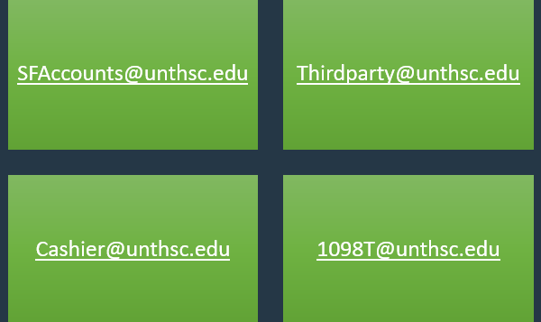

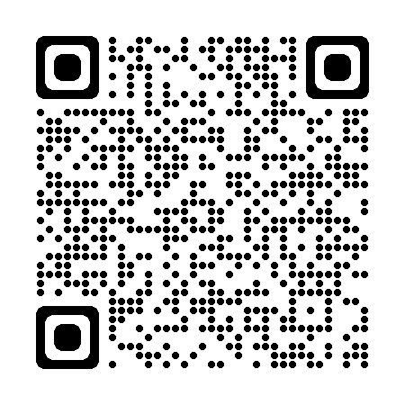
Contact Information
Notes:
The best way to contact us is through email. The SFAccounts email will be able to answer questions about your account, past due balances and payment plans. Also, there is a third-party email that will be able to assist you if you have third-party sponsor questions. The cashier email is the best contact to know when you can make an appointment to pay in person. Lastly the 1098-t email will be the email you correspond with if you are needing to submit a W-9 form or get information about your 1098-t. Follow our Facebook page. There we post reminders and other helpful information.

Slide 3
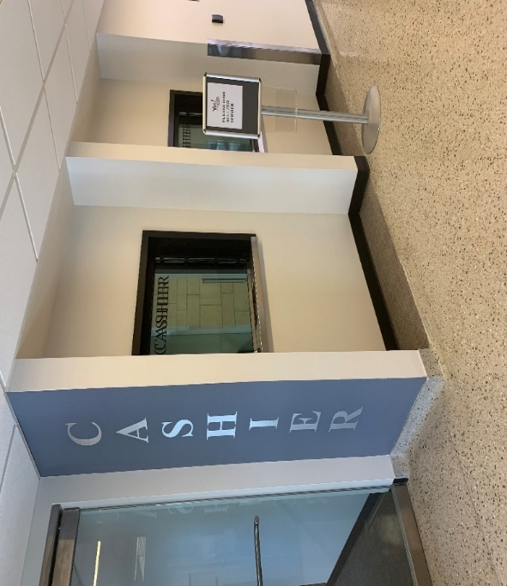
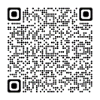
Location & Hours
1051 Haskell St. Fort Worth, Texas 76107
Student Finance Office
Cashier’s Office
M – F 9 am – 4 pm *Closure for lunch will vary depending on workload. Assistance is always available in Suite 150
M – F 8 am – 5 pm
SSC Suite 150, 1st Floor
SSC Suite 101, 1st Floor
Schedule Appointments Here!
Notes:
If you need to stop by our offices to make a payment or drop off any forms, we are in the Student Service Center, Suite 150 and the Cashier Office is in Suite 101. Payments are made by appointment only and available appointment times are Monday thru Friday between 9 am and 4 pm. The Cashier Office is closed daily for a lunch break, but assistance is always available in Suite 150. You can make an appointment online on the Cashier Services page using this QR code.

Slide 4
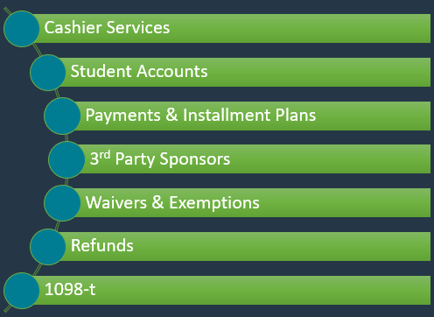
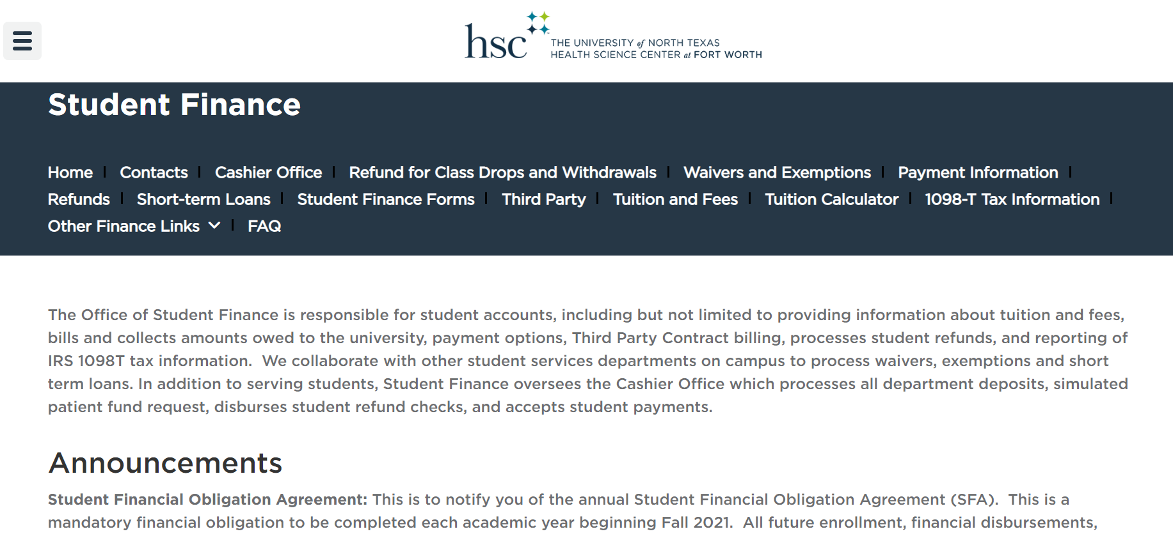
Services We Provide
Student Finance website
Notes:
It can be confusing as to what Student Finance does versus Financial Aid and the Registrar’s Office. We do work closely together, but we are separate offices. The services we provide are listed here. We manage student accounts by posting tuition and fees. We also process online payments and third-party sponsor payments. We offer payment plans, and we apply any approved waivers or exemptions to your account. We process refunds and distribute 1098-ts. The cashier’s office processes payments made by check, money order and flywire. Detailed information about what we do can also be found on our website.

Slide 5
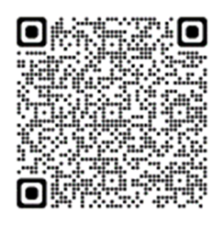
Payment Information
Full balance is due prior to the first day of the term. This includes tuition, fees, health insurance, etc.
Online Payments are made thru the Student Portal
myHSC | UNT Health Science Center
Pay in person or by mail with check or money order: Make Payable to: UNT HSC or Health Science Center
Cash is NOT accepted.
Drop Box Available at the Police Station
Notes:
Payment information. You can pay online through your student portal by clicking on the MyHSC link here. MyHSC>Student Account>View & Pay bill. This takes you to the QuickPay portal where you can enter your information to pay by echeck or credit card. If you choose to pay by echeck, you can avoid the credit card service fee. You can also enroll in a payment plan here as well. Please make checks payable to UNTHSC or Health Science Center. Again, payments are due the day before classes start. Never send cash through the mail.

Slide 6
International Payments
International students can use Flywire to make a payment. If you choose this option, please make sure you choose University of North Texas Health Science Center and not the University of North Texas Denton campus.
Go to pay.flywire.com
Find your educational institution (University of North Texas Health Science Center), select your country, and choose a payment method. Fill in your details, make your payment, and receive your confirmation.
If you have any questions, you may contact Flywire at:
Phone: 1-800-346-9252
Email: support@flywire.com
https://help.flywire.com
Notes:
International Payments are accepted through Flywire. Go to: pay.flywire.com, find your education institution (University of North Texas Health Science Center), select your country, and choose a payment method. Fill in your details, make your payment and then you will receive your confirmation. Please not when you receive confirmation that payment is processed, it may take 7-10 business days to reflect in your student portal. If you have questions, you can contact Flywire at: 1-800-346-9262; their email address which is: support@flywire.com or visit their website which is noted on this slide. Western Union will become another option for international payments in the future.

Slide 7
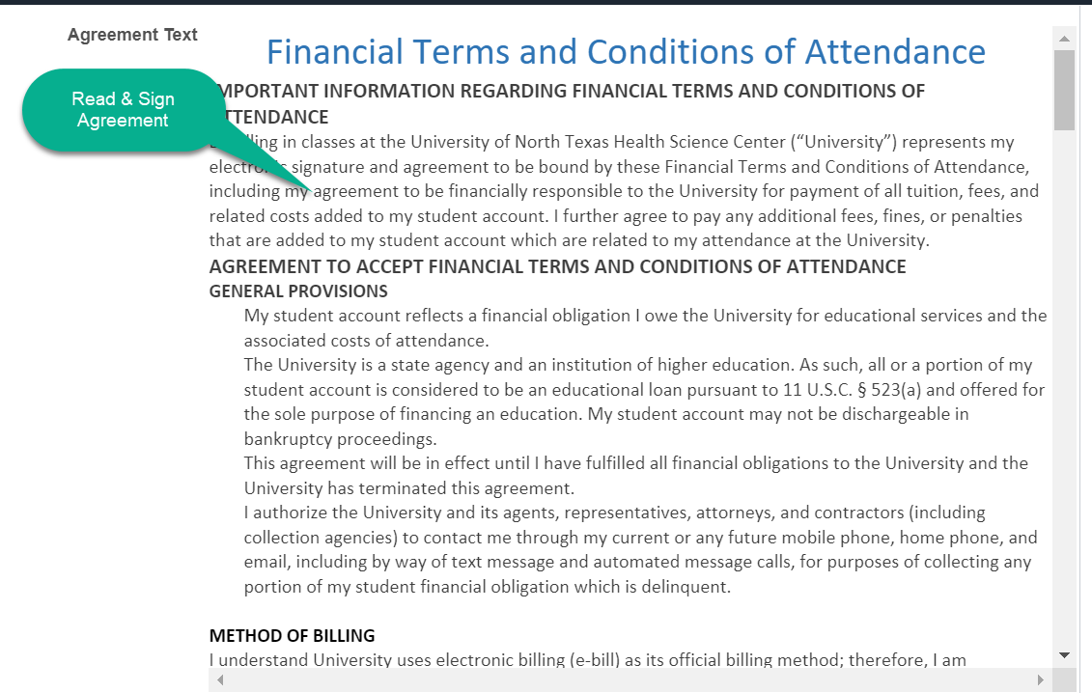
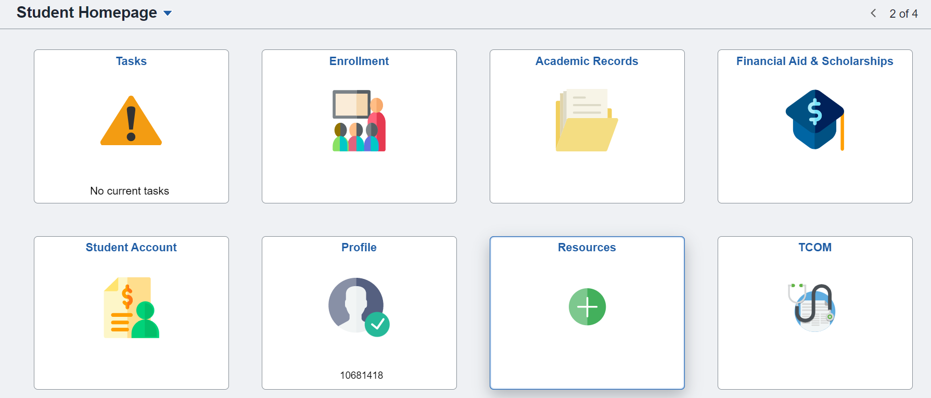
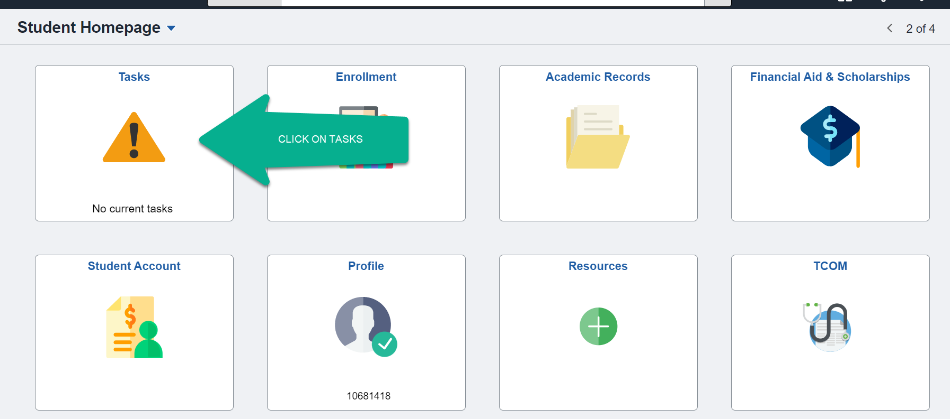
Student Financial Obligation Agreement
Notes:
The Student Financial Obligation Agreement (usually referred to as the SFO) is to be completed each academic year. This too is a part of your task list. The agreement in its entirety is printable in .pdf form from the Student Finance web page.

Slide 8
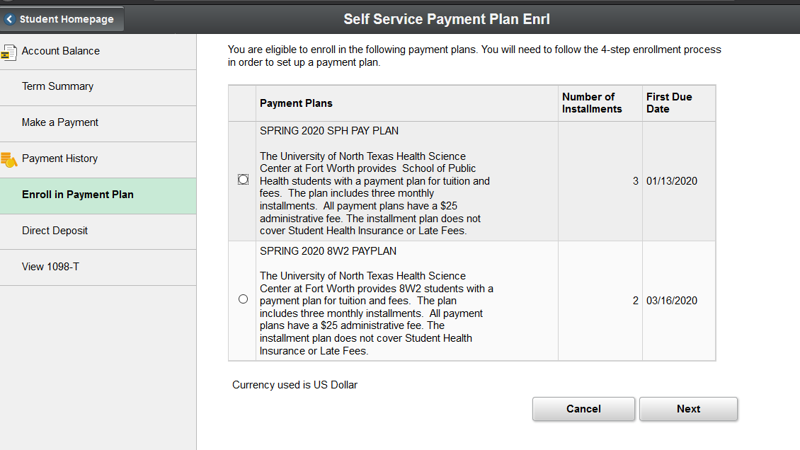
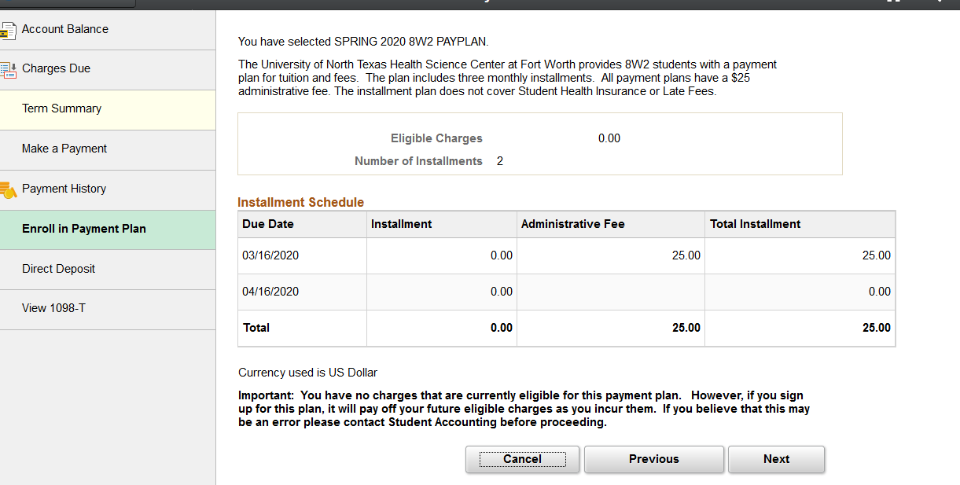
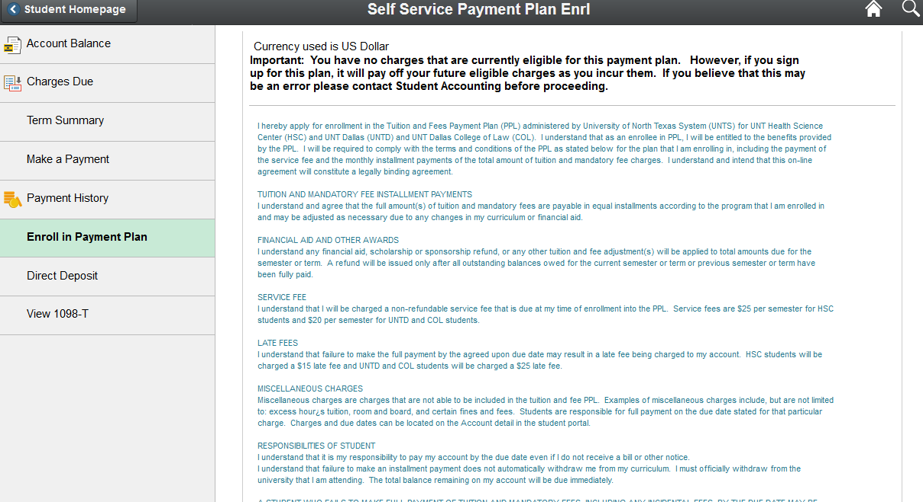
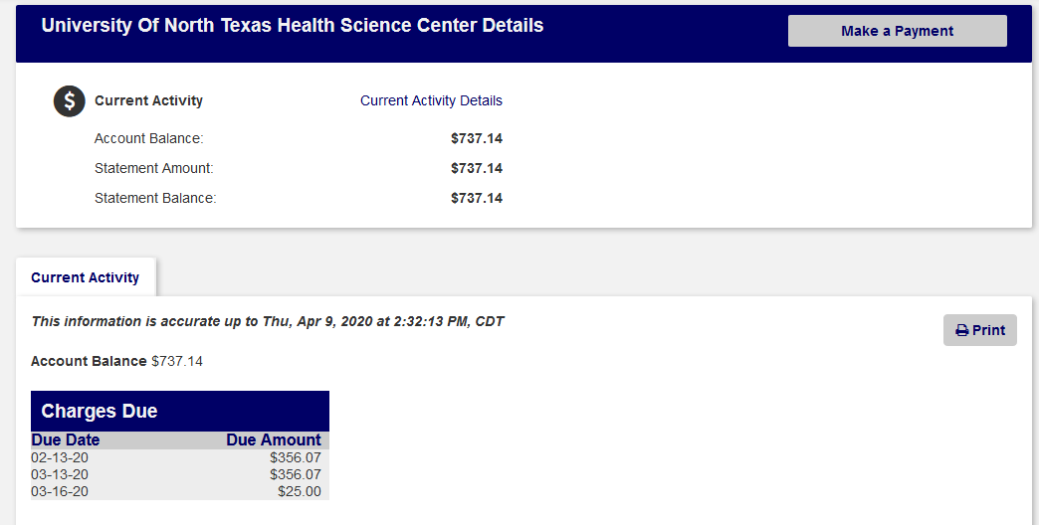
Payment Plans Fall & Spring terms ONLY
Notes:
Payment Plans are offered in the Fall and Spring terms ONLY. There is no payment plan for Summer. When you choose the installment plan the first payment is due BEFORE the first day of class. Keep in mind some fees are due in total regardless of the payment plan. (ex: Student Health Insurance).

Slide 9

Third Party Payments
Vendor/Sponsor must sign a contract (promise of payment).
  Third Party Contract can be found on our website, https://www.unthsc.edu/student-finance/student-finance-forms
Contracts must be submitted 10 days prior to the first day of class.
Students who use the Texas Guaranteed Tuition Plan-Texas Tomorrow (TGTP) must submit a copy of their TGTP card or In-state enrollment verification statement and Third-Party Student Agreement for TGTP to the Third-Party Coordinator at least 10 days prior to the first day of the term
For any question related to Third Party Contract/Billing benefits please email: ThirdParty@unthsc.edu or call 817-735-0676
Notes:
Third party payments are payments made for your tuition and fees by a vendor or sponsor. If you have a sponsor that will be paying your tuition, they must sign a contract, and this must be submitted 10 days prior to the first day of class. To find the contract please click the hyperlink on this page or see our website, Student finance forms at Student Finance at HSC Fort Worth (unthsc.edu)
For any question related to Third Party Contract/Billing benefits please email: ThirdParty@unthsc.edu or call 817-735-0676

Slide 10
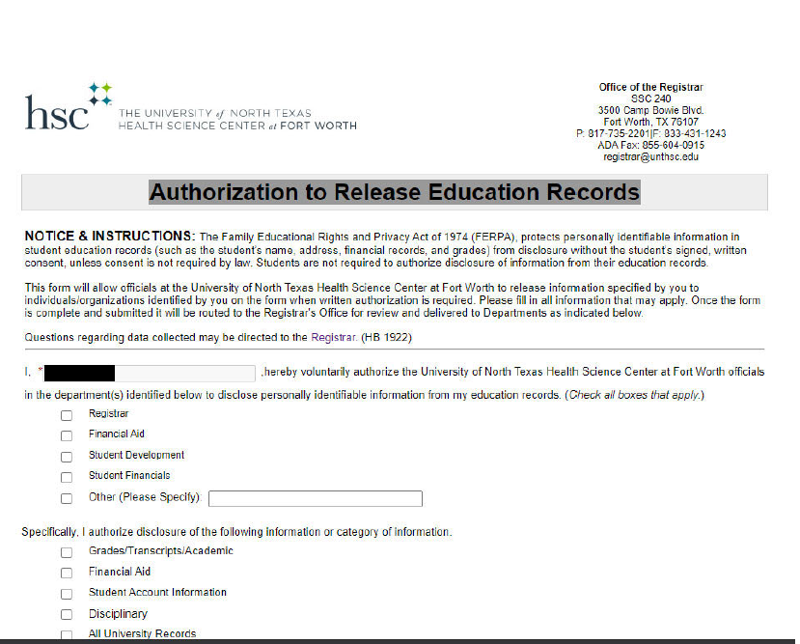
Authorization To Release Education Records
EXAMPLE OF AUTHORIZATION TO RELEASE EDUCATION RECORDS FORM
This is governed under the FERPA Act - Family Educational Rights and Privacy Act.
Notes:
Authorization to release education records is a form you can fill out if you wish for someone else to be able to discuss your records and billing. We will not share any information about your student account unless there is a form for them on file.
This is governed under the FERPA Act - Family Educational Rights and Privacy Act.

Slide 11



Make Sure Your Contact Information Is Up To Date
It is vital that your information with the school stays up to date.
Mailing Address Email Address Phone Number
Current Students – Update information on your Student Home Page > Profile
All official school communication is sent to your unthsc.edu email. It is your responsibility to check this. Remember you can forward unthsc.edu email to your personal email.
Notes:
Please be sure that your contact information is up to date. We will primarily communicate with you through your student email, but it is very important that your mailing address and phone numbers are correct.

Slide 12
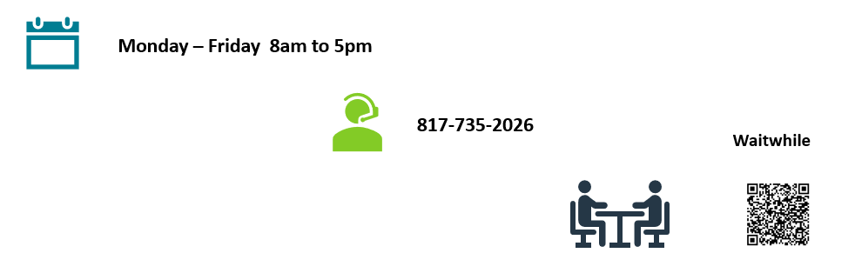
Contact Us
Notes:
Lastly, here is our main contact information again. Our business hours are from 8-5 Monday thru Friday. The best way to contact us is through email. If you choose to leave a phone message, we will get back to you at our earliest convenience. Thank you for your time and if you have any questions, please don’t hesitate to reach out to us.

