Slide 1


Office of Care and Civility
(OCC)
www.unthsc.edu/care-and-civility/
01

Slide 2

Our Why
To empower HSC students for behavioral and personal development through outreach and compassionate support.
02

Slide 3





Our
The Care Team
How
Student Conduct
To empower HSC students for behavioral and personal development through outreach and compassionate support.
Wellbeing Initiatives
Be|Well
03

Slide 4


Care Team
100% Support
0% Punitive
Campus-wide partnership, co-led with the Student Assistance Resource Center (SARC)
Support when life happens
817-735-2740
Person of Concern Reporting Form
Non-Clinical Assistance
04

Slide 5




Academic Dishonesty
Behavioral
Student
Conduct
On Generative AI
Read your syllabus.
Talk through expectations with your faculty.
01
Focus on growth and education, alongside accountability.
02
Our core responsibility is to help students.
03
We want to be proactive.
HSC Guidance for the Use of AI – Teaching and Instruction
05

Slide 6

Sex-based Violence Prevention
Wellbeing
Initiatives
Mental Health and Self-care
Suicide Prevention
We offer a variety of wellness, prevention, self-care, and awareness programs throughout the year.
01
Drug and Alcohol Abuse Prevention
02
Events are often hosted in person or virtually.
We collaborate with Register Student Organizations (RSOs).
03
04

Slide 7







Follow us!
01
02
03
Proactively addresses burnout in the health professions.
Wellbeing
Emotional intelligence
Resilience
07

Slide 8

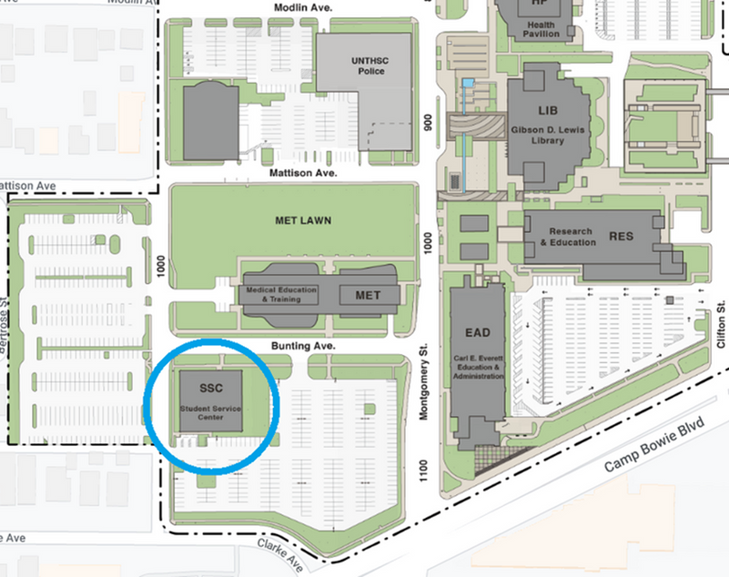
Where to Find Us!
Online!
In Person!
Or
08

Slide 9
Thank
You
Website
unthsc.edu/care-and-civility
Contact Us
occ@unthsc.edu
bewell@unthsc.edu
Questions?
10

