Slide 2
Office of Disability Access

Slide 3
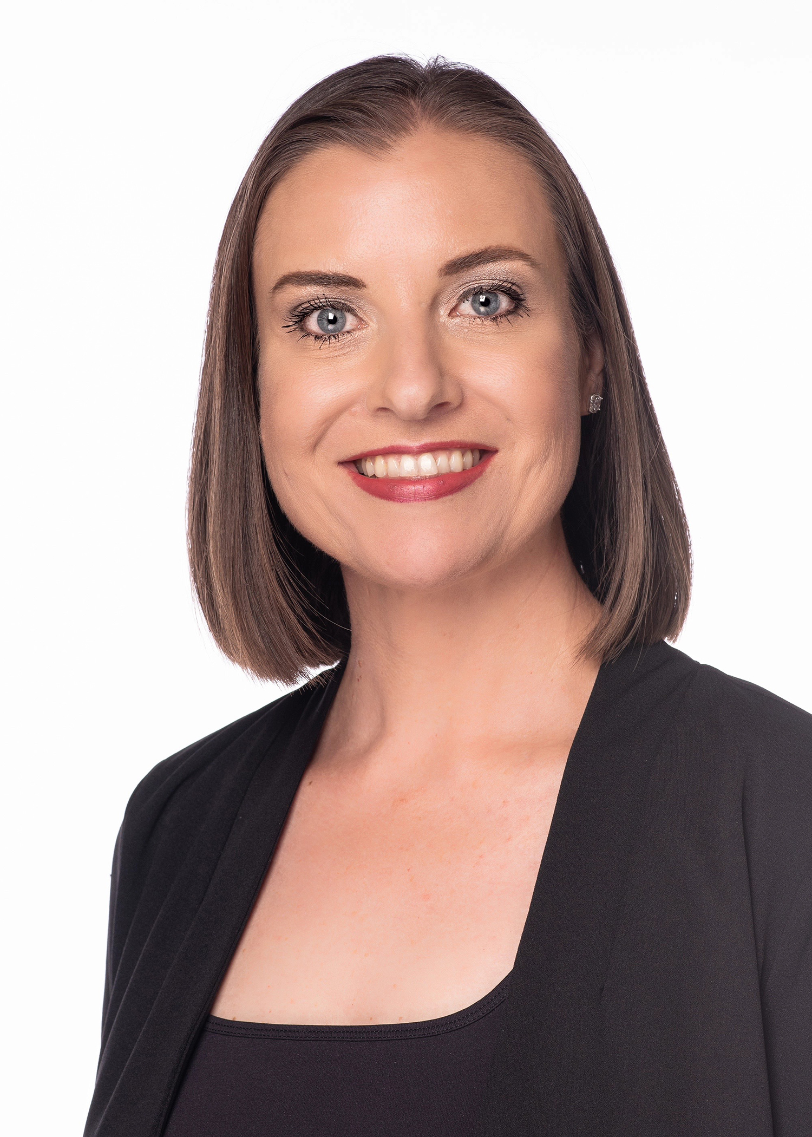
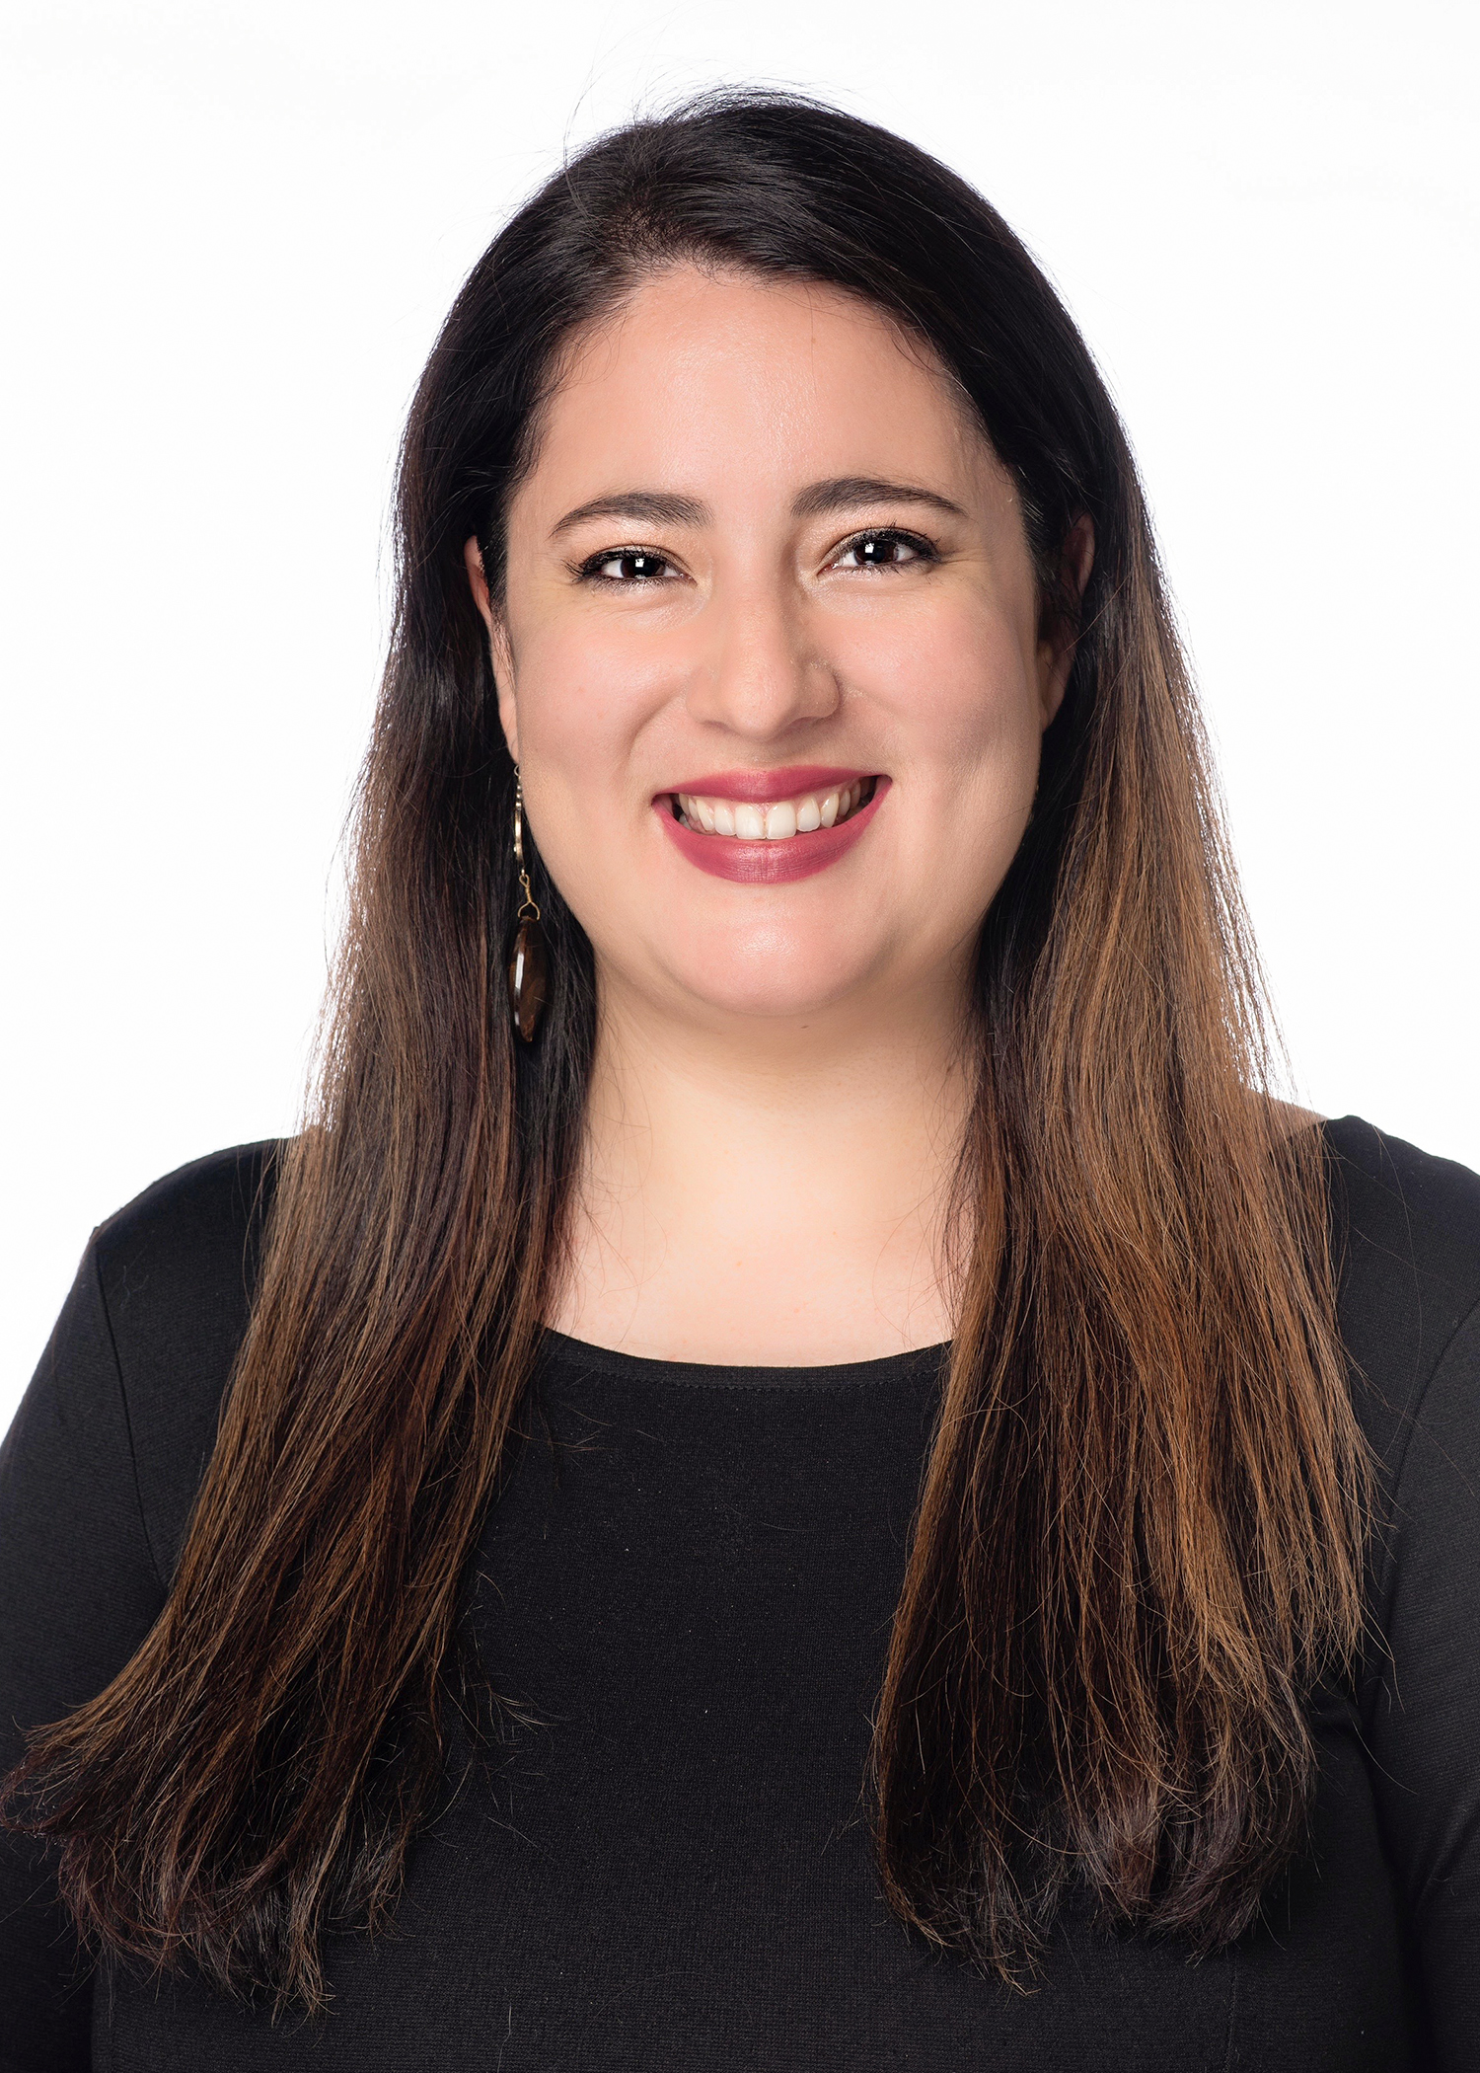
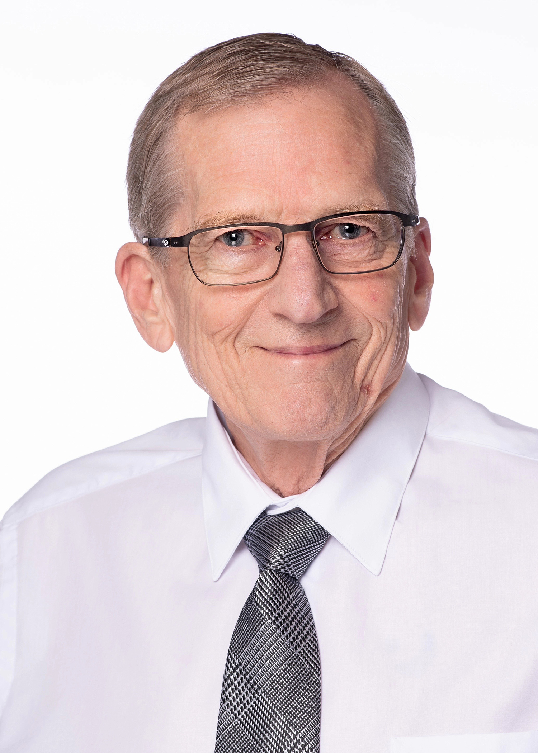
Meet the Team
Brandie Wiley:
Director Office of Disability Access.
Mariana Davies: Disability Access Coordinator
Robert Esterlein:
Testing Associate

Slide 4
Our Goal
The Office of Disability Access (ODA) is committed to assisting students with disabilities and providing academic accommodations to ensure equal access.
Our goal is to assist in the removal of barriers for students while maintaining the integrity and technical standards of each academic program.

Slide 5

Disability is Varied and Natural
ADHD
Generalized Anxiety Disorder
Learning Disability
Physical/Systemic Disability
Traumatic Brain Injury
PTSD
Diabetes
Bi-Polar Disorder
Blind or Low Vision
Deafness or Hard of Hearing
Seizure Disorder
Orthopedic Disorder
Major Depressive Disorder

Slide 6
Eligibility for Services
Currently enrolled/accepted for admission at the University of North Texas Health Science Center.
Have a permanent or temporary disability, as defined by the Americans with Disability Act and functional limitations which interfere with the student's academic functioning.
Complete an online application for accommodations, including the medical/diagnostic information sufficient to ascertain appropriate accommodations.

Slide 7
Step 1
Submit online application
Step 2
Provide documentation of disability
Step 4
Step 3
Schedule & attend registration meeting
Accommodation letter is generated by ODA
Registration Process

Slide 8
Student Responsibilities
Comply with standards of behavior and academic performance.
Initiate open communication with the Office of Disability Access staff regarding academic accommodation needs or problems which may arise.
Update documentation periodically, as the nature of severity of the disability changes, so that it accurately addresses current accommodation requirements.
Meet with the Office of Disability Access each semester to request accommodations.

Slide 9
Documentation Guidelines
Students requesting a reasonable accommodation under the Americans with Disabilities Act Amendments Act (ADAAA) and Section 504 of the Rehabilitation Act of 1973, as amended (Section 504) must provide specific and detailed information to the Office of Disability Access (ODA) from a qualified practitioner. Documentation received will be considered in determining whether a student is eligible for reasonable accommodations as defined by the ADA and Section 504.
Documentation Guidelines can be found on the ODA website: www.unthsc.edu/ODA

Slide 10
Confidentiality
ODA at UNTHSC strives to treat all personal information with the strictest confidentiality. We respect the privacy of individuals and will err in favor of confidentiality whenever possible.
It is the policy of the office to hold confidential all communications, observations, and information made by and/or between students, faculty, and staff whenever possible.
In some instances, ethical guidelines may require us to release confidential information without your consent.

Slide 11
Scheduling Meetings
Informational Meeting
An informal, confidential conversation to discuss your individual situation. We answer any questions and provide information about our office and our procedures.
Registration Meeting
Formal, confidential meeting to determine approved accommodations. Policies and procedures are covered.
General Meeting
Any meeting you want or need to have with our office after you are a registered student falls in this category.
Scheduling Process
You can schedule from the ODA home page: www.unthsc.edu/ODA or using Symplicity directly: https://unthsc-insight.symplicity.com/

Slide 12
Questions?
Contacts:
Brandie.Wiley@unthsc.edu
Mariana.Davies@unthsc.edu
Robert.Esterlein@unthsc.edu
ODA@unthsc.edu

